Slide 1

Go, change the world
RV College of
Engineering
Title of the Project
USN
Student Name
Under the Guidance
of
Internal Guide External Guide
Designation Designation
Affiliation Affiliation
Date Department of MCA, RVCE 1/14

Slide 2

Go, change the world
RV College of
Engineering
Agenda
Introduction
Changes suggested in Phase II and Incorporation
Implementation
Testing
Conclusion
References

Slide 3
Go, change the world
RV College of
Engineering
Introduction
The problem identified for the development of the PLM application is the lack of an efficient and comprehensive system to manage the entire product lifecycle.
Existing processes often involve manual and disconnected methods, leading to inefficiencies, errors, and delays in product development, as well as difficulties in collaboration and data management.
The domain of work for the PLM application encompasses product lifecycle management across various industries and sectors.
It caters to organizations involved in designing, engineering. manufacturing, and marketing of products, spanning from consumer goods to industrial machinery, electronics, automotive, and more.

Slide 4
Go, change the world
RV College of
Engineering
Incorporation of Changes
Changes in DFD and changes were incorporated
Changes in Functional requirement were suggested and incorporated

Slide 5
Go, change the world
RV College of
Engineering
Implementation
Module 1: Document Management
Input:
  Product-related documents such as design specifications, engineering drawings, user manuals, and compliance documents are input into the Document Management module. These documents can be uploaded by users or integrated from other systems. User inputs are received during document creation or modification processes, including document metadata (e.g., title, author, version), document relationships, and access control settings.
Process:
  Document Creation and Modification: The module includes functionalities to create new documents or modify existing ones. Users can input document content, attach files, and assign appropriate metadata.
  Version Control: The module ensures version control by maintaining a history of document changes, allowing users to access previous versions and track modifications.
  Access Control: User inputs are processed to define access permissions for documents, ensuring that only authorized individuals can view, edit, or delete specific documents.
  Document Search and Retrieval: The module's search functionality processes user queries and retrieves relevant documents based on keywords, document types, authors, and other specified criteria.
Output:
  Stored and Organized Documents: The output includes a well-organized repository of product-related documents accessible through the PLM application.
  Document Metadata and Version Information: Users receive outputs containing document metadata (e.g., title, author, creation date) and version details (e.g., version number, modification history).
  Search Results: Outputs present search results displaying relevant documents matching user queries.
  Access-Controlled Document Access: The module provides outputs indicating which users have access to view or modify specific documents.

Slide 6
Go, change the world
RV College of
Engineering
Implementation
Module 2: CAD Integration
Input:
  CAD Data Files: Users input CAD data files from various design software, such as AutoCAD or SolidWorks, into the PLM application.
  User Inputs: Users provide inputs during the CAD data import process, such as specifying import settings, desired file formats, and conversion options.
Process:
  CAD Data Import: The module processes user-provided CAD data files and imports them into the PLM system. The data is converted into a format compatible with the PLM application.
  CAD Data Visualization: The module enables users to visualize CAD designs directly within the PLM user interface, facilitating review and collaboration.
  Synchronization: The module ensures synchronization of design changes between the PLM system and CAD applications, enabling seamless updates to design data.
Output:
  Imported CAD Data: The output includes the successfully imported CAD data, integrated into the PLM application for further use.
  CAD Design Visualization: Users can access outputs displaying visualizations of CAD designs within the PLM user interface.
  Design Synchronization Status: Outputs provide notifications indicating the status of design synchronization between the PLM system and CAD applications.

Slide 7
Go, change the world
RV College of
Engineering
Implementation
Module 3: Quality Assurance
Input:
  Quality Test Results: Inputs to the Quality Assurance module include data from product quality tests and inspections conducted during the manufacturing process.
  User Inputs: Users provide inputs related to quality control checklists, inspection criteria, and non-conformance details.
Process:
  Recording Quality Test Results: The module processes data from quality tests and records the results, including pass/fail statuses and measurement data.
  Quality Inspections and Audits: The module manages quality inspections and audits, ensuring adherence to specified standards and procedures.
  Non-Conformance Management: User inputs are processed to identify and manage non-conformance issues, triggering corrective actions and resolution procedures.
Output:
  Recorded Quality Test Results: Outputs present comprehensive reports on quality test results, including pass/fail outcomes and measurement details.
  Compliance Status and Quality Metrics: Users receive outputs indicating compliance status and key quality control metrics for products.
  Non-Conformance Notifications: The module provides outputs notifying users of non-conformance issues, along with updates on corrective actions and resolution progress.

Slide 8
Go, change the world
RV College of
Engineering
Implementation
Module 4: Report and Analytics
Input:
  Product Data and Performance Metrics: Inputs include product-related data, performance metrics, and key performance indicators (KPIs) collected from various stages of the product lifecycle.
  User Inputs: Users provide inputs specifying report parameters, analytics preferences, and the selection of specific data for analysis.
Process:
  Customizable Report Template Creation: The module allows users to create customizable report templates to suit specific reporting needs and requirements.
  Data Aggregation and Analysis: Inputs are processed for data aggregation and analysis, enabling the generation of insights and trends.
  Visualization: The module processes user inputs to visualize analytical findings through charts, graphs, and interactive dashboards.
Output:
  Comprehensive Reports: Outputs present comprehensive reports based on user-selected templates, including data summaries and performance evaluations.
  Visualizations and Analytics Insights: Users receive outputs featuring visualizations and analytical insights, facilitating data-driven decision-making.
  Key Performance Indicators: The module provides outputs displaying key business metrics and performance indicators for products and processes.

Slide 9
Go, change the world
RV College of
Engineering
Unit Testing
Module 1: Document Management
Test Case ID | Description | Input | Expected Output | Actual Output | Remarks
DM-TC-001 | Document Creation - Valid details | Document details (title, author, version) | New document is created with provided details | New document created successfully | Pass
DM-TC-002 | Document Creation - Missing information | Incomplete document details | Appropriate error message is displayed | Error message displayed as expected | Pass
DM-TC-003 | Document Creation - Unique ID | N/A | Document ID is unique for each created document | Document ID is unique as expected | Fail
DM-TC-004 | Document Creation - Unique ID | N/A | Document ID is unique for each created document | Document ID is unique as expected | Pass

Slide 10
Go, change the world
RV College of
Engineering
Unit Testing
Module 2: CAD Integration
Test Case ID | Description | Input | Expected Output | Actual Output | Remarks
CAD-TC-001 | CAD Import - Valid CAD file | CAD file in supported format | CAD file is successfully imported | CAD file imported successfully | Pass
CAD-TC-002 | CAD Import - Invalid CAD file | CAD file in unsupported format | Appropriate error message is displayed | Error message displayed as expected | Fail
CAD-TC-002 | CAD Import - Invalid CAD file | CAD file in unsupported format | Appropriate error message is displayed | Error message displayed as expected | Pass
CAD-TC-003 | CAD Import - Metadata Update | Updated CAD file metadata | CAD file metadata is updated | Metadata updated successfully | Pass

Slide 11
Go, change the world
RV College of
Engineering
Unit Testing
Module 3: Quality Assurance
Test Case ID | Description | Input | Expected Output | Actual Output | Remarks
QA-TC-001 | Inspection Creation | Inspection details | New inspection is created | Inspection created successfully | Pass
QA-TC-002 | Audit Creation | Audit details | New audit is created | Audit created successfully | Fail
QA-TC-003 | Inspection Results | Inspection findings and results | Inspection results are recorded | Results recorded successfully | Pass
QA-TC-004 | Audit Creation | Audit details | New audit is created | Audit created successfully | Pass

Slide 12
Go, change the world
RV College of
Engineering
Unit Testing
Module 4: Report and Analytics
Test Case ID | Description | Input | Expected Output | Actual Output | Remarks
RA-TC-001 | Report Generation | Report criteria and parameters | Report is generated and displayed | Report generated successfully | Fail
RA-TC-002 | Report Generation | Report criteria and parameters | Report is generated and displayed | Report generated successfully | Pass
RA-TC-002 | Data Extraction | Data extraction parameters | Relevant data is extracted and available | Data extracted successfully | Pass
RA-TC-003 | Analysis and Visualization | Analysed data and visualization parameters | Analysis and visualization are generated | Analysis and visualization successful | Pass

Slide 13
Go, change the world
RV College of
Engineering
Result and Conclusion
The results of the custom application will be adapted to the organization's particular aims and objectives. The Document Management module empowers users to efficiently manage product-related documents. From creation to modification and version control, the module ensures secure storage and easy accessibility. By implementing access control and robust search functionalities, collaboration among teams is enhanced, resulting in increased productivity and better data management.
The CAD Integration module seamlessly integrates the PLM application with CAD software, enabling smooth import, conversion, and visualization of CAD data. This synchronization fosters collaboration between design teams and ensures accuracy in product design and development. By facilitating a cohesive interface with CAD applications, the module promotes innovation, reduces errors, and expedites design processes.
The Quality Assurance module focuses on maintaining product quality through inspections, audits, and non-conformance control. The module records test results, facilitates compliance tracking, and identifies quality issues promptly. By prioritizing product quality, the module enhances customer satisfaction and fosters a culture of continuous improvement within the organization.
The Report & Analytics module empowers users to gain insights through the generation of comprehensive reports and visualizations. Customizable report templates cater to specific needs, while data aggregation and visualization tools aid in analysing product data effectively. These reports support decision-making, process improvement, and strategic planning, contributing to enhanced product development and overall business success.

Slide 14
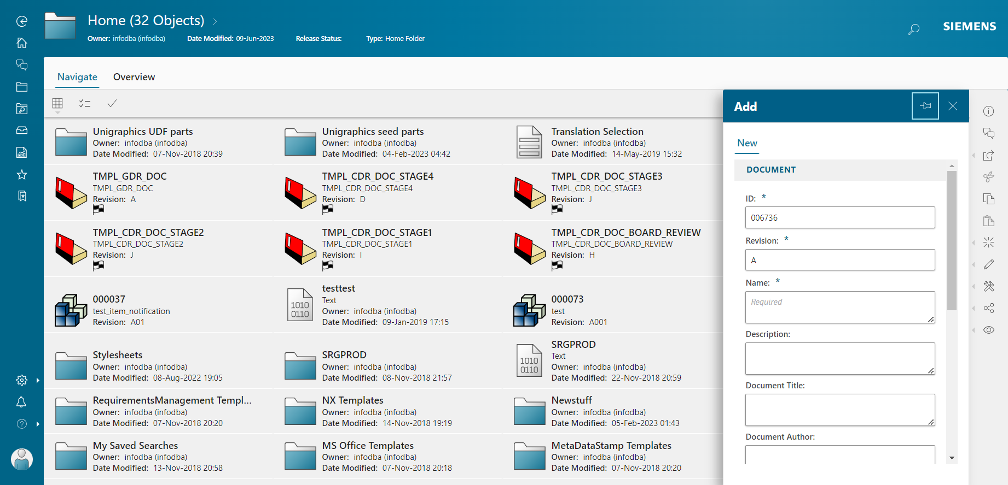
Go, change the world
RV College of
Engineering
Screen shots of Result
Document Management

Slide 15
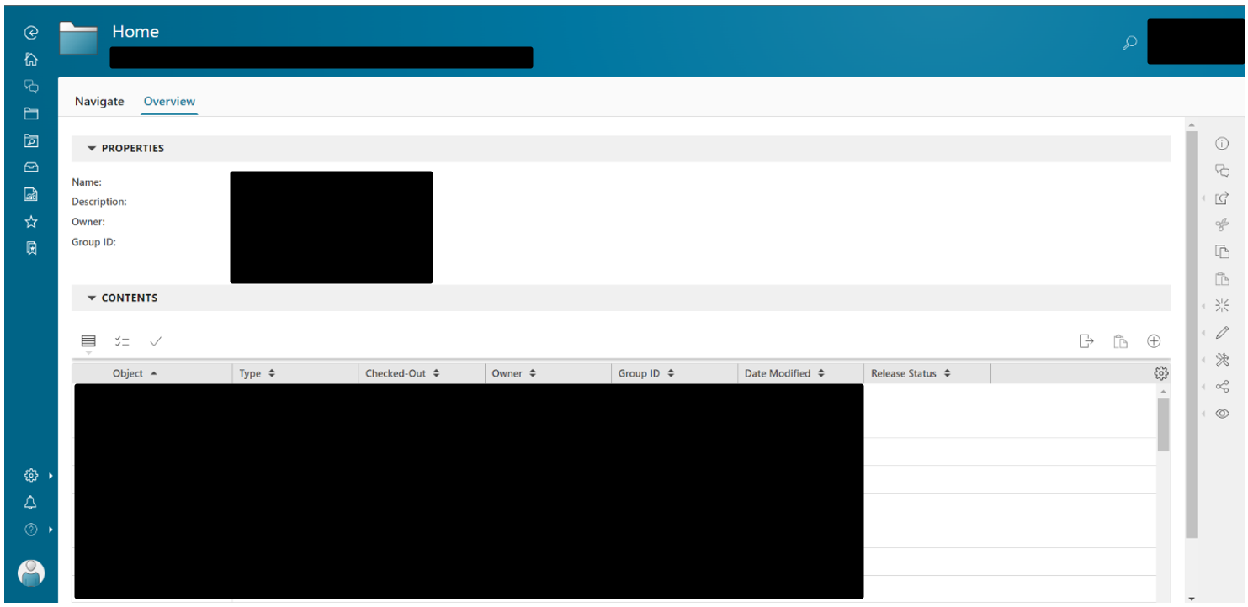
Go, change the world
RV College of
Engineering
Screen shots of Result
Document Management

Slide 16
Go, change the world
RV College of
Engineering
Screen shots of Result
Document Overview

Slide 17
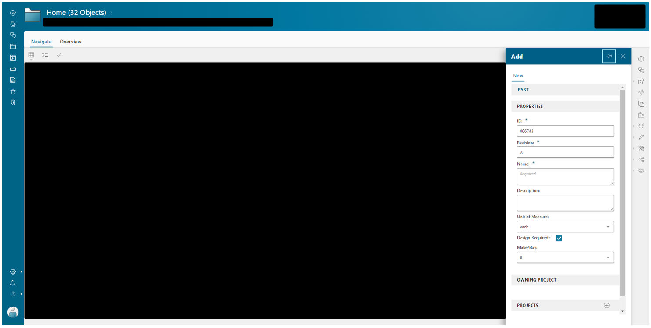
Go, change the world
RV College of
Engineering
Screen shots of Result
Creating new CAD file

Slide 18
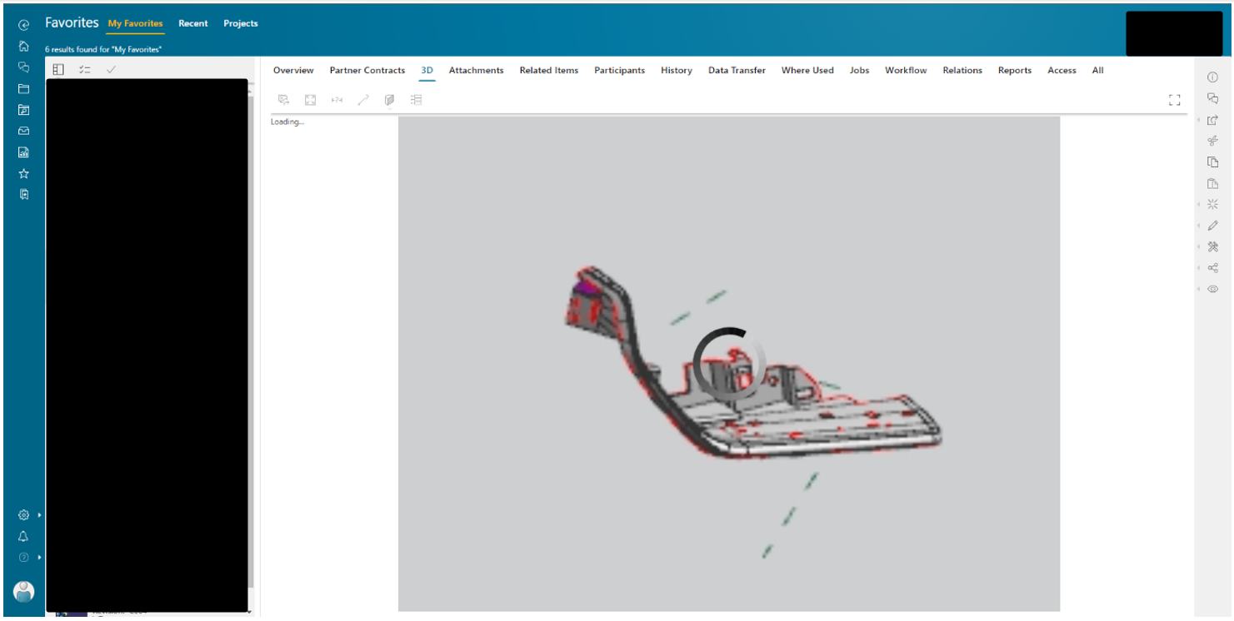
Go, change the world
RV College of
Engineering
Screen shots of Result
Creating New Design

Slide 19
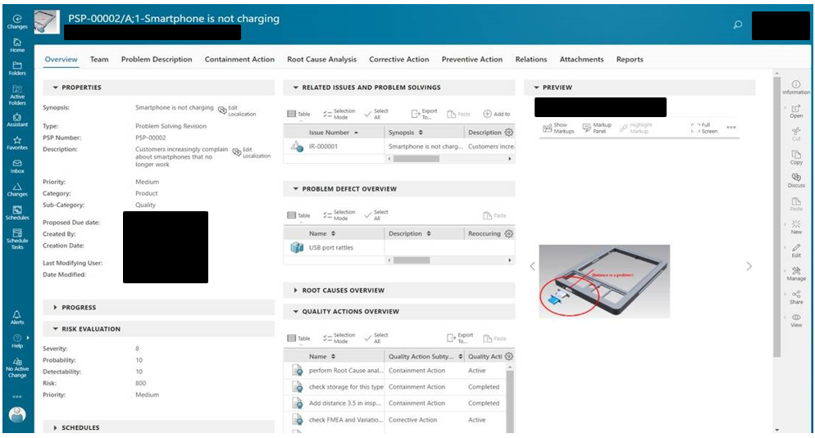
Go, change the world
RV College of
Engineering
Screen shots of Result
Quality Assurance

Slide 20
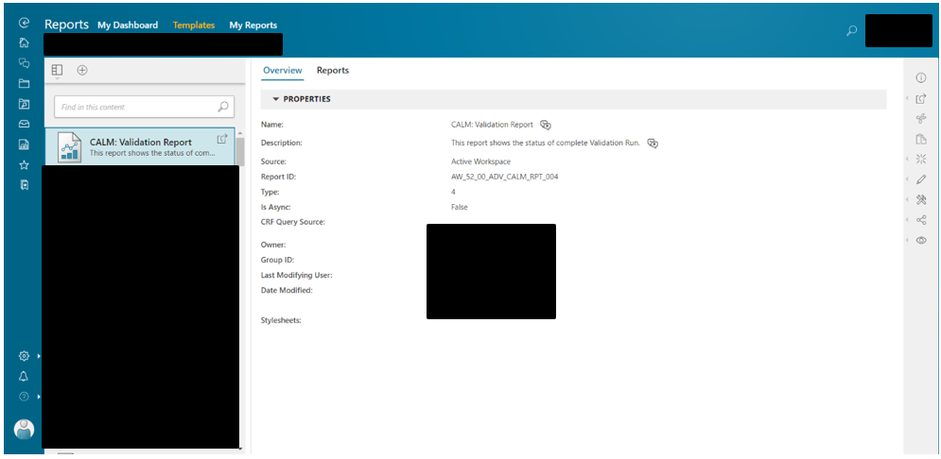
Go, change the world
RV College of
Engineering
Screen shots of Result
Reporting and Analytics

Slide 21
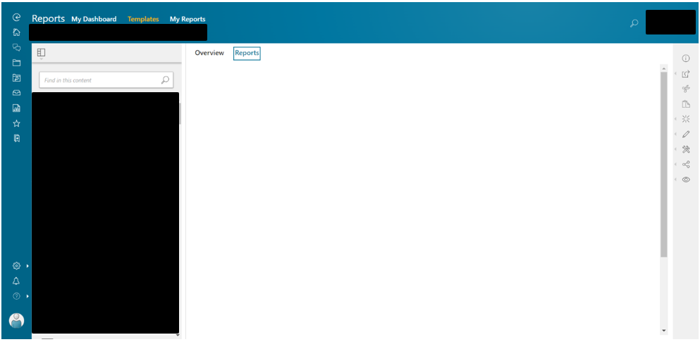
Go, change the world
RV College of
Engineering
Screen shots of Result
Report Overview

Slide 22
Go, change the world
RV College of
Engineering
Screen shots of Result
Reporting and Analytics

Slide 23
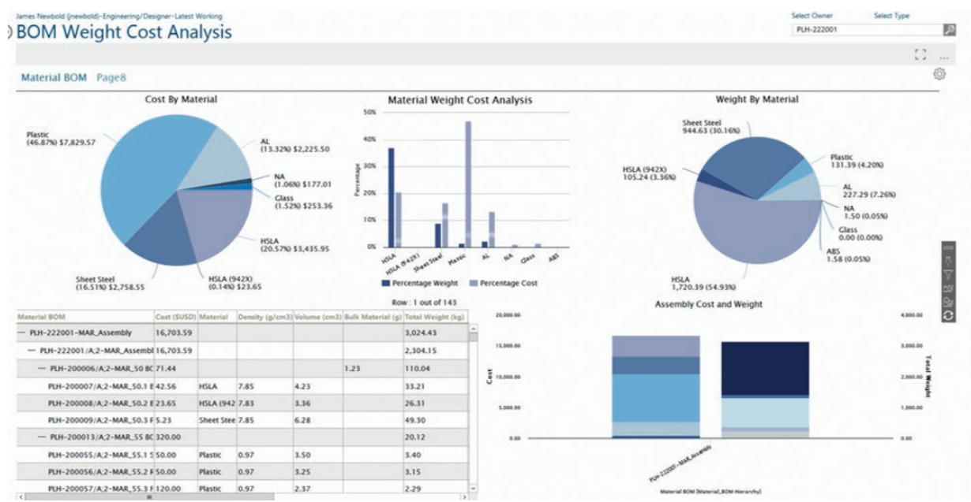
Go, change the world
RV College of
Engineering
Screen shots of Result
PLM Analytics

Slide 24
Go, change the world
[1] A. Smith et al., "A Framework for Customizing PLM Systems to Support Engineering Change Management” Journal of Sustainable Engineering, 2021
[2] B. Johnson et al., "Customizable PLM Solutions for Small and Medium-Sized Enterprises" Journal of Engineering Visualization, 2023
[3] C. Lee et al., "Adaptive and Agile Customization in PLM Systems" Journal of Information Security, 2021
[4] D. Brown et al., "Integration of Custom Applications with PLM Systems: Challenges and Solutions" Journal of Product Lifecycle Management, 2022
[5] E. Wang et al., "A Review of Customization Approaches in PLM Systems" Rapid Prototyping Journal, 2022
[6] F. Chen et al., "User-Centric Customization of PLM Interfaces: A Case Study" Journal of Concurrent Engineering, 2022
[7] G. Liu et al., "Customization Framework for PLM Systems Based on Modular Architecture” International Journal of Engineering Management, 2021
[8] H. Zhang et al., "Evaluating the Performance of Custom PLM Applications: Metrics and Benchmarks”. Rapid Prototyping Journal, 2022
[9] I. Davis et al., "Integration of Customized PLM Applications with Enterprise Resource Planning Systems" Journal of Information Security, 2021
[10] J. Smith et al., "A Comparative Study of Custom PLM Solutions and Off-the-Shelf Systems" International Journal of Human-Computer Studies, 2021
RV College of
Engineering
References

Slide 25
[11] K. Anderson et al., "Agile Development of Custom PLM Applications: Lessons Learned from Industry Projects” Journal of Sustainable Engineering, 2021
[12] L. Chen et al., "Custom PLM Applications for Supply Chain Collaboration in Global Manufacturing" International Journal of Mass Customization, 2021
[13] M. Johnson et al., "Data Integration Challenges in Custom PLM Solutions: A Systematic Review" IEEE Transactions on Engineering Management, 2023
[14] N. Wilson et al., "Exploring the Benefits and Challenges of Cloud-Based Custom PLM Applications” Journal of Concurrent Engineering, 202
[15] P. Thompson et al., "User Acceptance of Customized PLM Systems: Factors Influencing Adoption” Neural Computing and Applications, 2021
[16] Q. Davis et al., "Security and Privacy Considerations in Custom PLM Applications" International Journal of Advanced Manufacturing Technology, 2021
[17] R. Garcia et al., "Economic Analysis of Customization Options in PLM Implementations" Journal of Engineering Visualization, 2023
[18] S. Turner et al., "Custom PLM Applications for Product Data Visualization and Simulation" International Journal of Service Science, Management, Engineering, and Technology, 2022
[19] T. Mitchell et al., "Impact of Custom PLM Applications on Organizational Processes and Workflows" Journal of Data Integration and Management, 2022
[20] V. Patel et al., "Integration of AI and Machine Learning in Custom PLM Solutions: Current Trends and Future Directions" Journal of Engineering Visualization, 2023

